Slide 1
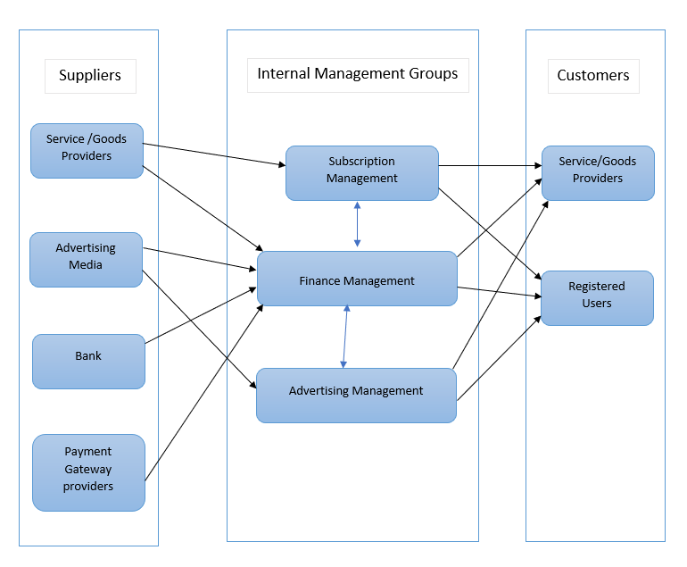
QuickFeed Business Relationship Map

Slide 2
User Roles by Business Group
External Users (Customers)
Service/Goods provider(Akshay, Sathvik)
Registered Users(Sayali, Sagarika)
Internal Users
Business Group | User Roles | Team Member Name
Subscription/Account Management | Subscription Analyst | Lakshmi Bhavani
Advertising Management | Advertising Analyst | Nitesh
Finance Management | Accountant | Shubham

